Slide 1
Restaurant Revenue Prediction
Team 11: Nash Kleisner, Jill Maguire, Jennifer Zhang, Yixuan Zhu

Slide 2
Problem Statement
Problem: New restaurant sites take a large amount of time and capital to start up. When poor locations are chosen, losses are incurred.
Goal: To minimize losses by predicting revenue at various locations of 100k regional locations in Turkey as potential new restaurant sites.
Notes:
Our problem is about finding the right location for new restaurant open to increase the revenue

Slide 3
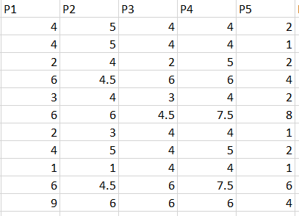
Dataset
Training data : 137 records
Testing data : 100000 records
Data Fields :
Id
Open Date
City: there are unicode in the names
City Group : Big City , Other
Type of restaurants: FC (Food Court) , IL (Inline), DT (Drive Thru), MB (Mobile)
P1, P2 - P37: Three categories of obfuscated data: Demographic data, Real estate data, and Commercial data
Revenue : To be Predicted
Notes:
43 variables, Demographic data are gathered from third party providers with GIS systems. These include population in any given area, age and gender distribution, development scales. Real estate data mainly relate to the m2 of the location, front facade of the location, car park availability. Commercial data mainly include the existence of points of interest including schools, banks, other QSR operators.

Slide 4
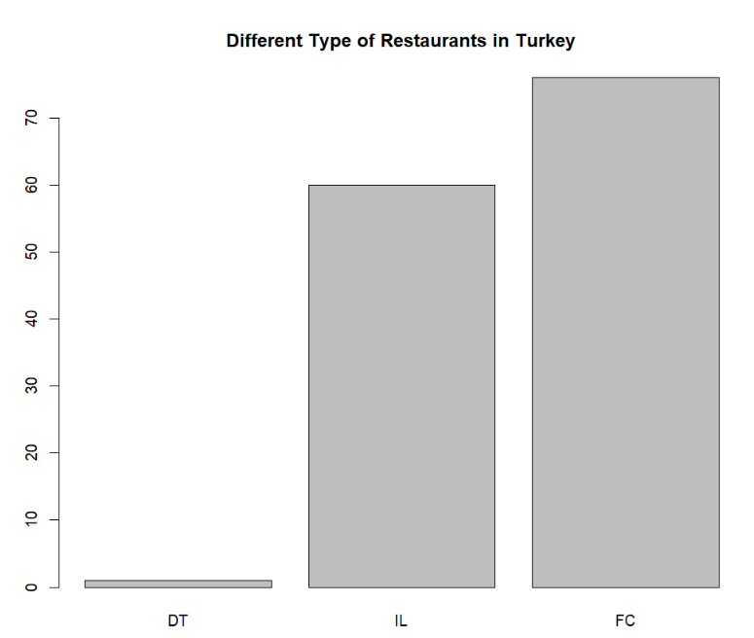
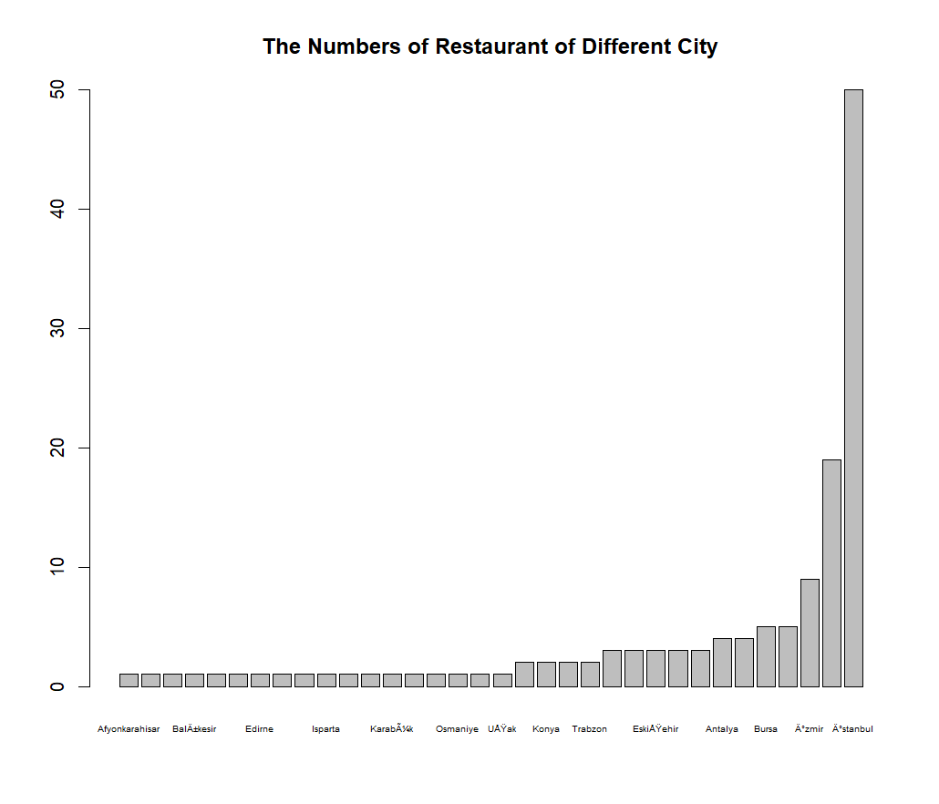
Dataset Visualization
Notes:
Barplot in of train data

Slide 5
Critique
Extremely difficult to understand code
Despite comments
Illogical decisions made and not well explained
No data cleansing
Uses all columns to build model
Issues with multicollinearity
e.g. between City and CityGroup
May explain extremely low R2 values

Slide 6
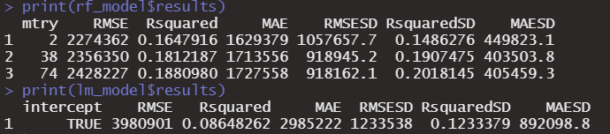
Critique
Poor RMSEs
Extremely low R^2 values

Slide 7
Critique
Unclassed City variable - converted to labels
submission is looking for city names but there are none in test_new
Not all factor levels are present in both training and test
Confused unclass function
Causes code to not be able to run
Solution: changing Type and City to factors instead of unclassing
Notes:
Do we want to show pics/files of other code that exists?

Slide 8
Our Solution
Deep clean the data
Only use the important features to build the model
Analyze revenue variable and take the log to normalize
Convert data type of the features
Use cross-validation to find the appropriate parameter of models
Compare R square and performance of three models:
Random Forest 0.9085
Boosting 0.9131
SVM 0.7424
For reproducibility, comment code and use understandable, consistent variable naming
Notes:
Pull up and walk through code

Slide 9
Conclusion
The model we tested with the highest R2 value - 0.9131 - was our boosted model
Random forest was not that far behind
SVM performed much worse
boosting is the only model that “learns” off previous iterations
weak learners compile to create a strong final model
which is why it performed slightly better than Random Forest

Slide 10
Thank you!

